Slide 1

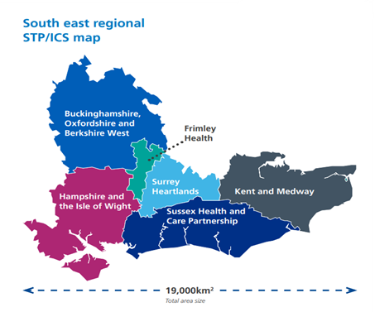
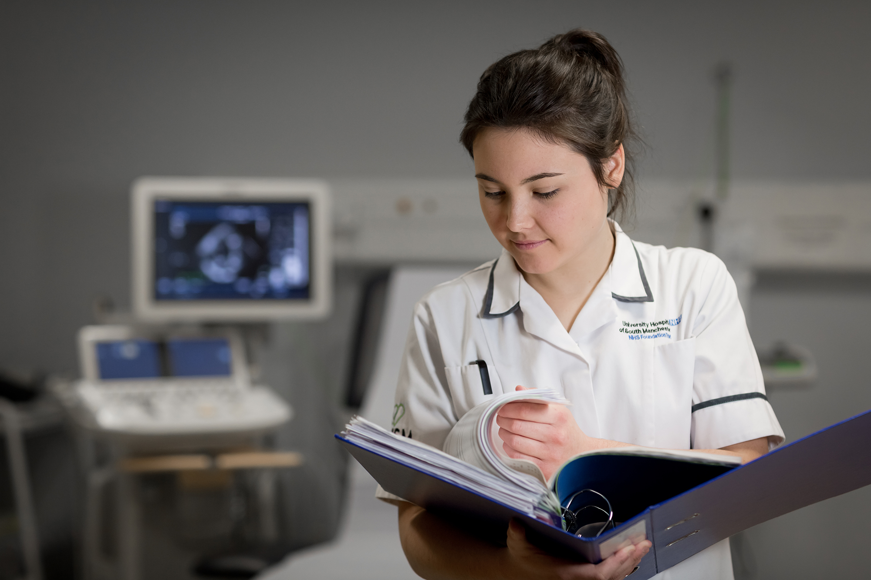
Return to Practice for the South East
Claire Wardle SE RTP regional lead claire.wardle@hee.nhs.uk
returntopractice.se@hee.nhs.uk
Notes:
Introduction
Return to practice agenda supports previous nursing and midwifery registrants to return to the register.
Specialist Community public health nurses SCPHN

Slide 2
Overview
General RTP offer
Routes to return in the South East
Funding and support available
University programmes for Nursing and Midwifery with Specialist Community public health nurses (SCPHN)
Further resources
Notes:
Specialist Community public health nurses SCPHN

Slide 3
Routes for nurses and midwives who are seeking readmission to the Nursing & Midwifery Council (NMC) register
1. Direct admission https://www.nmc.org.uk/registration/returning-to-the-register/readmission/
2. RTP course university –combines a level 6/7 academic programme and supernumerary clinical practice placement in order to achieve the practice-based requirements for the course (University normally guides about duration).
3. Test of Competence (TOC) known as OCSE – all fields of nursing and midwifery
Notes:
For return to register as a SCPHN, Specialist Community Public Health Nursing (this includes school nursing, health visitors, occupational health nursing, and family health nursing) you first need to register as a nurse or midwife. The university will send NMC details at the end of the returners course. NMC then will write to returner and ask them to go online to finish the returner readmission application. This will put returner back on the register as a nurse or a midwife. When they are back on the register, NMC will ask the university to email them to confirm that the return to practice course also covered your SCPHN qualification.
Direct admissions
Registered practice hours of 450 over previous three years or 750 hours over previous five
• 35 hours of continuing professional development (CPD) in the last three years
Moving from temporary registration to full registration and you can use hours gained while practising on the temporary register, process a little different - Most people can apply for readmission through NMC Online and can take up to 6 weeks.
2. RTP course – Traditional programme and placement model can vary from 3-9 months. Most popular to support SCHFN
3. TOC a computer based test and practical skills based exam - OSCE.

Slide 4
RTP course via a University - offering Nursing and SCPHN
University | Delivery | Intake | Contact
Canterbury Christchurch University | Blended | September | karen.hynes@canterbury.ac.uk
Brighton University | Online | September and February | G.Whittaker@brighton.ac.uk
Plymouth University ( also offer Midwifery) | Online | September and February | adele.kane@plymouth.ac.uk
University of Northampton | Blended | February, May and Sept | ros.wray@northampton.ac.uk
Notes:
Universities that offer return to practice offer specific fields of nursing adult, child, mental health, learning disabilities and health visiting.
Specialist Community Public Health Nursing (this includes school nursing, health visitors, occupational health nursing, and family health nursing)
All can vary slightly in terms of delivery. Work closely with local employers.
Placements are generally found by the university HEE can support if issues or perhaps considered out of area.
A minimum of 15 practice hours is required per week, over a minimum of two 7.5 hour shifts per week up to full time hours for the duration of the programme.
University of Greenwich *** South East offer Midwifery January
Face to Face
January
K.Pearce@greenwich.ac.uk

Slide 5
Test of Competence route www.nmc.org.uk/toc21
Launched in January 2020 for RTP potentially offers a quicker route back to practice
Apply through NMC for Part I Computer based test (CBT) and Part 2 Objective Structured Clinical Examination (OSCE)
Practical test that requires preparation
Self Funded route or undertake through an employer.
Costs £878
Fees will be reimbursed by HEE on successful re-registration to the NMC and proof of employment.(Details of criteria on Health Careers website and NMC Test Centres)
Developing employer led route with NHS Trusts to prepare for TOC
Notes:
TOC - Objective Structured Clinical Examination (OSCE)
Launched in January 2020 for RTP, Funded by HEE The ToC does not require you to attend a university, or a clinical placement, and could potentially offer a quicker route back to practice – ideal if you are only out of clinical practice for a short while. 6-8 weeks to prepare 14 different skills
This is a practical test made up of 10 different stations. Four stations will be linked together around a scenario: one station for assessment, planning, implementation, and evaluation, four stations to test skills, and two stations to assess the candidate's values and behaviours and evidence-based practice.
NMC Test centres currently in SE - Oxford,/Swindon, Northampton and N Ireland
CBT – computer based test The multiple-choice computer based theoretical test (known as the CBT) is split into two parts. Part A will cover numeracy and Part B will cover clinical questions.

Slide 6
Model of return
Unpaid/voluntary route – Traditional placement model whilst studying at university
Paid employer led route – Employed model
Notes:
With the voluntary route, you are not paid whilst you are on your return training, so you will not receive a salary during your placement, but you will receive a £1000 bursary from HEE South East. The benefit of this option is that you can maintain your current financial situation – crucial if you are on benefits, or have another job. This is paid via the university normally
With the paid/employer-led route, supported to undertake the programme and could be paid a Band 3 and 4 role. These roles are advertised on NHS jobs.
You will find a mixture of these models and what we can try and do is to try and support you to find the best return route for you

Slide 7
Funding
Course fees for University programmes paid directly by HEE
Stipend – Training grant £1000 - Childcare, books, travel for returner if not employed in a healthcare role paid by HEE. If employed this funding goes to employer.
HEE provide a placement fee for employer £500
TOC – self funding returners are reimbursed and HEE fund employers £2000 supporting TOC returners
Enhanced offer £5000 for employers supporting returners back to LD, MH, Midwifery and Cancer nurse returners for starts before March 31st 23.

Slide 8
Key contacts and resources
SE regional RTP email - returntopractice.se@hee.nhs.uk
National RTP Nursing Team contact details : returntopractice.wm@hee.nhs.uk
https://www.healthcareers.nhs.uk/explore-roles/nursing/returning-nursing/returning-nursing
https://www.healthcareers.nhs.uk/explore-roles/midwifery/returning-midwifery
https://www.nmc.org.uk/registration/returning-to-the-register/completing-a-test-of-competence-for-return-to-practice/
www.nmc.org.uk/toc21
Notes:
Key contacts and links to further resources
National nursing Team, and website health careers and NMC pages.

