Slide 1
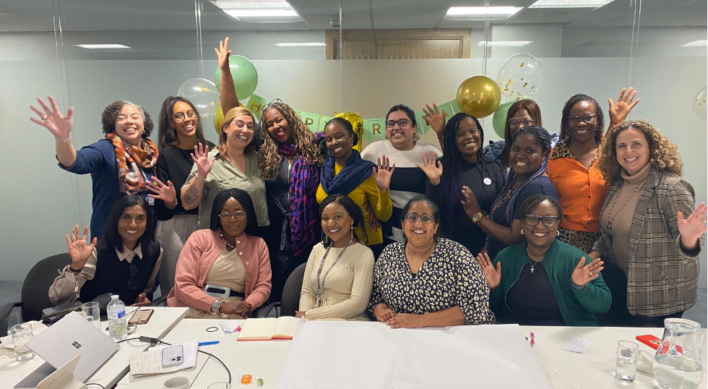
South East Region Maternity and Neonatal Ethnic Minority Workforce - Expert Reference Group
Angela Velinor, FHEA, Deputy Regional Chief Midwife Anita Finlay, Head of Clinical Programmes

Slide 2
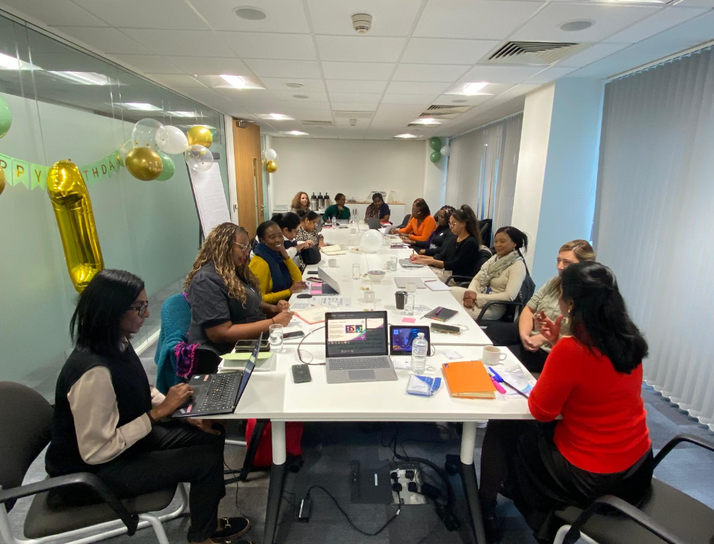
Vision
To create a robust, efficient and upskilled group to deliver an inclusive, equitable, and innovative maternity care system that ensures the highest standards of health and wellbeing for all mothers and newborns, irrespective of their backgrounds.
To develop the skills necessary to effectively advocate for much needed change to prepare services for the future.

Slide 3
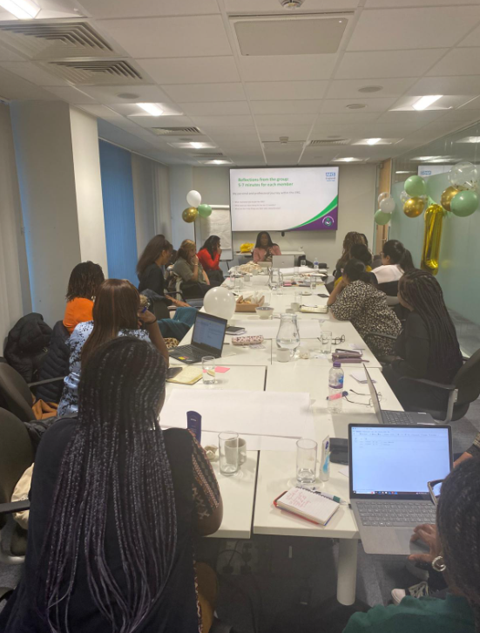
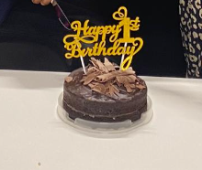
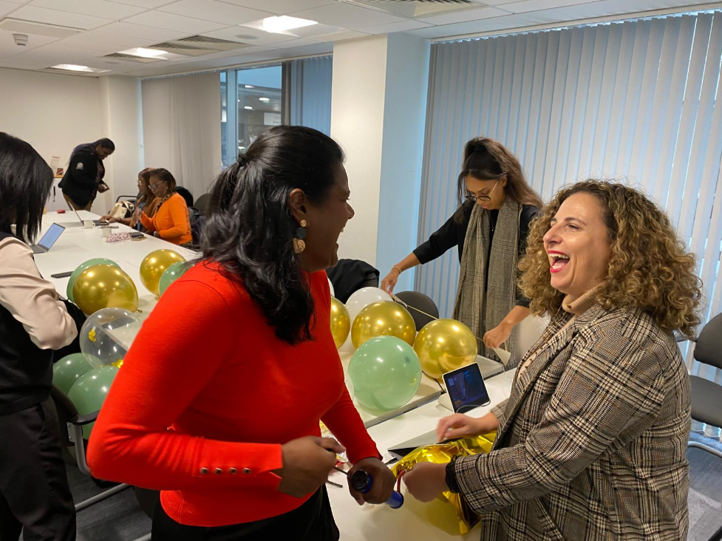
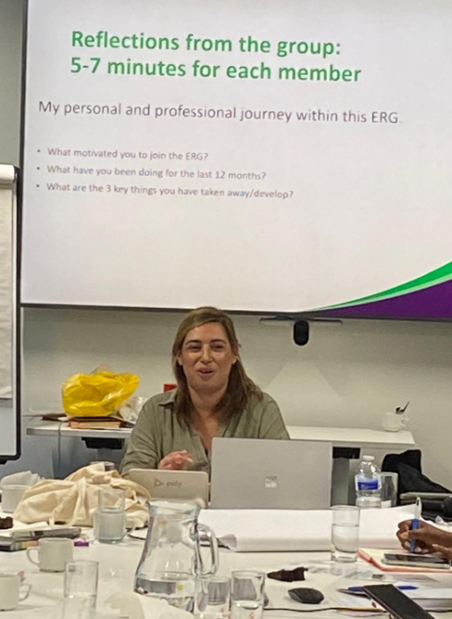
What have we achieved after one year
Core membership
Strategy finalised/ ToR finalised
Support offer for coaching and mentoring
Support offer for talent and leadership development
Real time intervention for members needs
A dedicated platform on the NHSE webpage

Slide 4
Strategy creation
Strategic outcomes
Enhance Talent and Development: Foster continuous professional growth and skill enhancement. Ensure a thorough understanding of the importance of talent management and career development in maternity services.
Address Health Inequalities: Understand, identify and mitigate health disparities to ensure equitable care for all populations. Encourage and implement innovative solutions that address current challenges in maternity care. Be familiar with evidence-based strategies and tools for targeted innovative interventions to deliver results.
Effective Leadership: Develop effective and inclusive leadership within the group to drive sustainable improvements and inspire positive change.
Talent and development
Strategic alignment to maternity outcomes
Health inequalities
Leadership

Slide 5
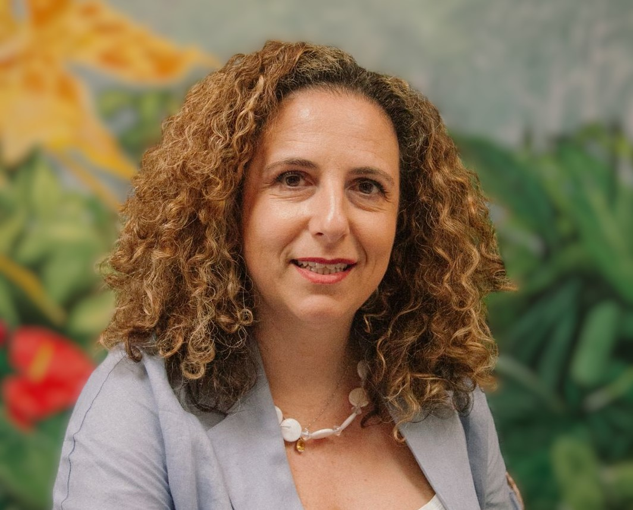
How do we support them?
Offer to ERG members - Leadership Coaching Conversations
The purpose of the sessions is to support each member to reflect on their experiences and how they impacted their leadership journey; to support the development of their own inclusive leadership narrative; to practice reflective and reflexive thinking and to identify actions to take forward in line with the ERG vision.
Session 1 – 60 minutes Session 2 – 30 mins (Goal setting)
Objectives
To gain greater self-awareness
To empower themselves and others around them
To make sense of their experiences in the context of affecting change
Themes identified
Cristina LaCara
Psychodynamic Executive Coach – Group Facilitator
Navigating organisational culture
Maintaining wellbeing
Managing emotions
Impact of discrimination
Supporting others
Building resilience and refocusing
Reframing unhealthy beliefs
Regulating emotions

Slide 6
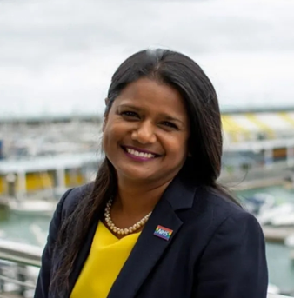
Support offer
Offer to ERG members - Talent support and strategic planning
The group members are offered talent support aligned to the strategy and objectives of ERG. Support is offered to the chair and programme lead a monthly basis.
Objectives
Support strategy development and delivery plan
Enhance Talent and Development
Support the group with innovation around health inequalities
Dedicated support with Bio’s/ interview prep etc
Support members Talent and development
Support the chair with the Strategic Alignment to Maternity outcomes
Align Health inequalities goals to strategy
Support inclusive leadership development
Cavita Chapman
Inclusive Leadership and Talent

Slide 7
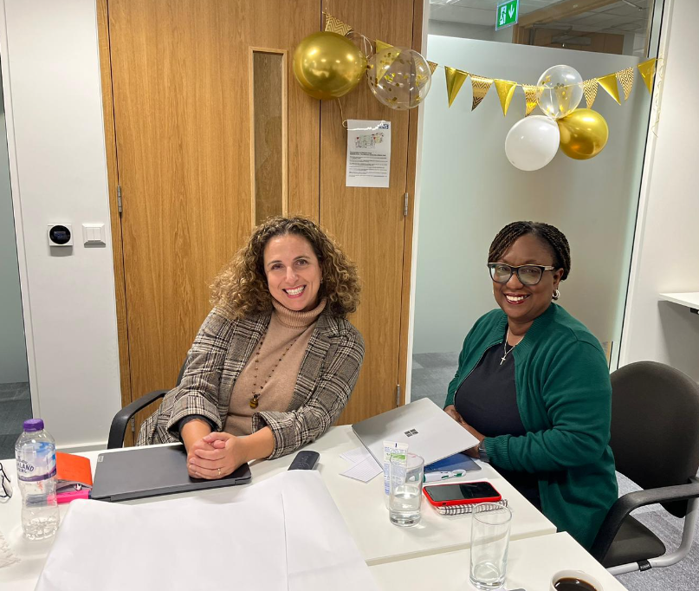
Cultural transformation: Real-time intervention for ERG members based on their feedback
Since the inception of the ERG our members have had accelerated growth with an innovative mindset. One challenge has been some of the behaviours that they are received with back in their organisations. Examples below
“You should be focusing on the job at hand only”
“This is not within your remit”
“This is not in your portfolio”
“Don’t get carried away”
“You don’t have permission to…”
Dedicated sessions around the following
How to help senior leaders listen in a way that creates excitement for what you do
How to help senior leaders identify challenges for patients from an ethnic minority background and understand why ERG members are in a position to support this work
Supporting our ERG members with tools and strategies to share their work
Supporting our ERG members with strategies to help their senior staff align their own work with the work of the ERG
Help ERG members realise that they don’t need permission to improve quality outcomes for patients

Slide 8
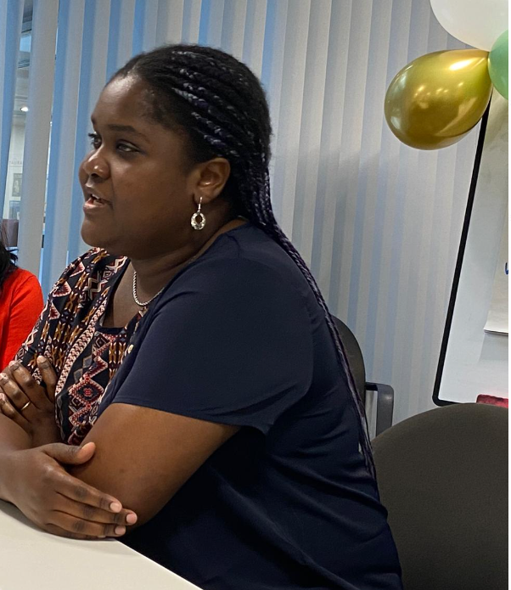
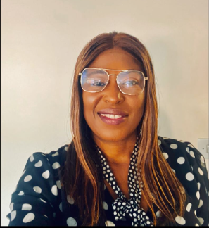
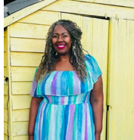
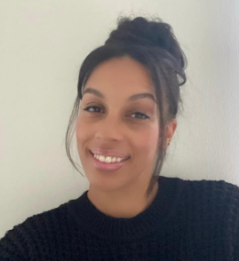
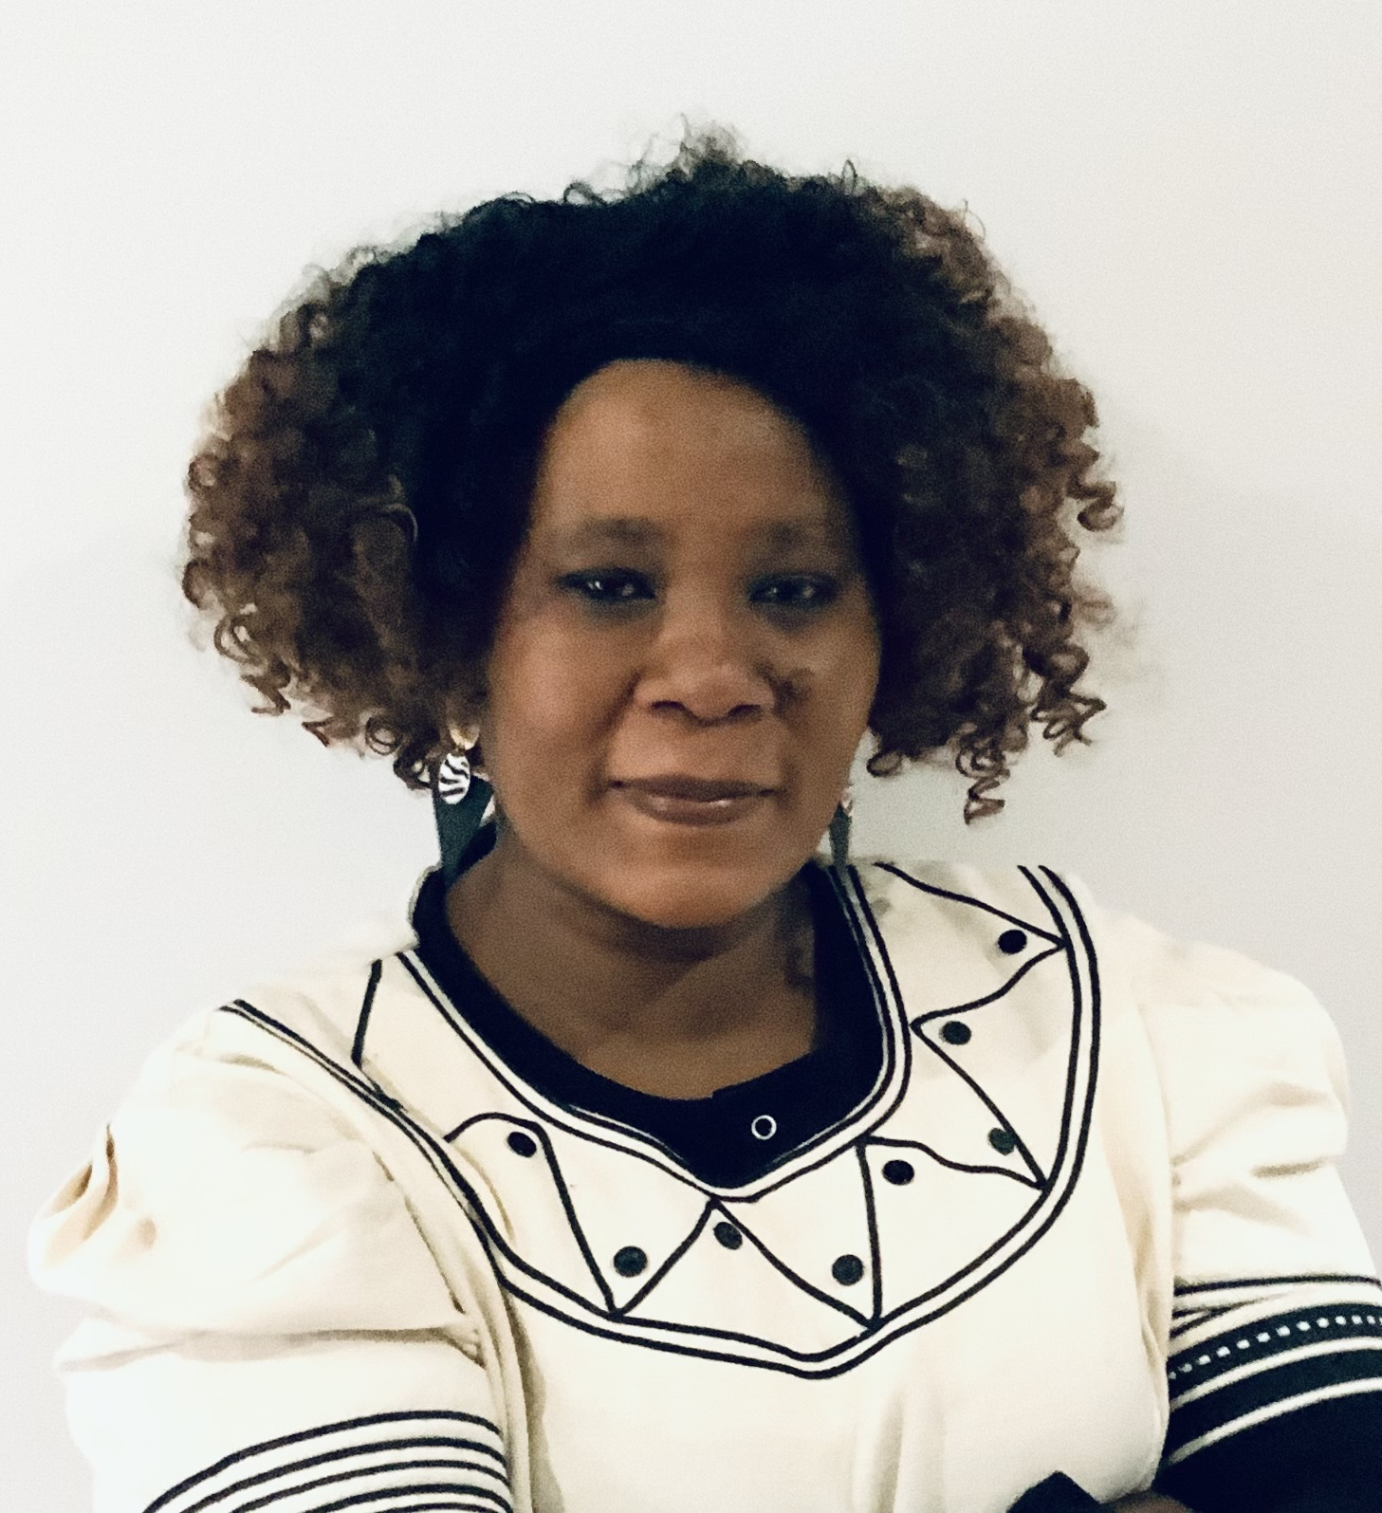
Feedback from our experts
“I joined the ERG to connect with a community of like-minded individuals dedicated to addressing inequality. By engaging with this group, I aim to maintain a broad perspective on the equity landscape, ensuring our efforts are impactful and aligned with a shared vision of inclusion and fairness. Over the past year, I have focused on developing the Equity, Diversity, and Inclusion (EDI) framework for my trust. This involves responding to the needs of service users, students, and staff, assessing the impact of my interventions, and using these insights to shape our EDI operations. I’ve also been sharing my progress and learning from initiatives in other areas to continuously enhance our approach.
“Being part of the ERG allows me to connect with a supportive community that fosters personal growth and amplifies my voice and impact within the NHS.” Dr Helen Gbinigie
“Thank you to the ERG for your support and commitment to this vital work. Looking ahead, I am eager to develop enhanced mentorship and coaching for NHS staff transitioning from band 7 to 8, create personalized online antenatal classes that are equitable, and share our publication plan widely on social media to reach families facing significant health inequalities. Together, we can continue to build a more inclusive and equitable healthcare system.” Michelle Comrie
Through this experience, I’ve gained three key insights: First, equity work can be isolating and stressful, making a supportive network essential for rejuvenation. Second, I’ve learned the value of collaborating intelligently with colleagues and leadership to build mutually beneficial relationships. Finally, I recognize the importance of continuous learning and sharing, as engaging with others fosters fresh perspectives and collective growth, helping us make a meaningful impact together.” Carina Okiki
“I feel part of this ERG because I can share, learn and network. In the last 12 months I have been developing the MSW framework , developing training and supporting workforce progression. I am proud to be part of the ERG because I love the value of networking, the benefits I will get from coaching and mentoring and the importance of me giving my feedback.” Sam Dodoo
“I joined the ERG to foster a more inclusive workplace, gain valuable experience, and advance my passion for improving global women's health in underprivileged communities, aspiring to work with organizations like FIGO.”
Dr Chimwemwe Kalumbi

Slide 9

What it means to be part of this ERG
“Being a part of this ERG means I will get support with reaching my full potential as a future leader as well as empowering me to help and support others to reach their goals.”
“Being part of the ERG means I will get holistic support with all aspects required for me to progress in my career and reach my full potential.“
“Being part of this ERG group means I will get support with developing my leadership skills to achieve my goals while supporting and advocating for others to deliver equitable care.”
“As part of the ERG Group, I have a voice to share my midwifery experience, support fellow members, and serve as an advocate.”
“Thank you this is really helpful I am not applying for a job as yet but will use this for my next move so thank you.”
“Being part of this ERG means I will receive support from fellow amazing peers who share the same values for equitable care and empowering those we care for and work with.”
“Being part of this ERG group means I get peer support and feel truly heard”.
“Being part of the ERG provides peer support, which makes me feel empowered. Seeing such hard-working, goal-orientated, passionate people come together makes me believe we can be the change that is needed.”

